Slide 1
DevOps via the HelpDesk
Sneaking in good practice with JEA

Slide 2



Thank You To Our Sponsors

Slide 3
Me
Stuart Moore
20+ years in IT. Supported most Operating systems and database platforms. Now mainly gluing together disparate systems mainly using PowerShell
Run the East Midlands SQL User Group and co-organiser of SQL Relay
Email: stuart@stuart-moore.com
Twitter: @napalmgram
Blog: https://stuart-moore.com

Slide 4
The age old problems
You want to implement some cool new techniques you saw at a conference
Management don’t buy into it
Colleagues can’t see the point
Can’t find a suitable ‘easy’ project to demo it on
You’re swamped with all the small jobs that come steaming through the helpdesk so no time!

Slide 5
The problem contains the solution
Automate fixing the helpdesk calls, or allow them to be fixed elsewhere
It’s easy, you’re already doing the work so you know the fix
Your colleagues will buy into it once they see you doing more interesting things than cloning a database for the developers again, or unlocking an access account again
Once you’re all doing more interesting things, and helpdesk calls are getting fixed quicker, Management will get interested
Job Done!

Slide 6
But is that DevOps?
It is if you do it right it’s got most of the points people associate with it:
Source Control
This code is important it needs to be version controlled
Testing
You’re going to rely on it so it’s needs to be tested
Improved Feedback
Implement telemetry, you can see how it’s be used.
And users will be keen to tell if it’s working
Automation
Better than doing it manually, and less likely to go wrong
Faster delivery of Value Added work
Most of these tasks don’t really add value, so by removing, reducing or accelerating you can do work that does Add Value

Slide 7
JEA – Just Enough Administration
A Role Based means of granting limited access to administrative functions
Create constrained endpoints that users connect to
Users connected to endpoint run the commands as a specified VirtualUser with higher permissions
Endpoint limits the access the connected user has to commands and language features, even which parameters they can specify
Different users connecting to the same endpoint will be offered different commands and options

Slide 8
Not just for helpdesk
Do you really need to run with full permissions all the time?
Would it be a good idea to log what you’ve been doing?
Can prevent running the wrong thing on the wrong environment
By simplifying things you stop being the ‘Something’ Person

Slide 9
Constrained EndPoints
Endpoints are what PS Remoting sessions connect to
Managed by
These can be constrained by:
Permissions of who can connect to the endpoint
What commands are available to the connected user
Which language features are available to the connected user
DEMO

Slide 10
Creating an endpoint
Needs to be in a PowerShell module structure
Basic skeleton is enough
Needs to be in a standard module location
Where users can’t edit it is a good idea ☺
Add a RoleCapabilities folder to the module structure
Contains a PowerShell Session Configuration file (.pssc)
Contains a PowerShell Role Capability file (.psrc)

Slide 11
Configuration Changes
Session Config (.pssc)
Must be reregistered to take effect
Needs a WinRm restart
Role Capabilities (.psrc)
Just needs to be replaced
Will take affect next time a session starts

Slide 12
Constraining the Session
Restrict who can connect
RoleDefinitions = @{}
Restrict the language features available
SessionType
Configure the user ultimately running the commands:
RunAsVirtualAccount
Network Access as Computer Account
RunAsCredential
GroupManagedServiceAccount
Enforcing environment configuration
Force modules and versions loaded
Enforce environment setup

Slide 13
Constraining the role
Only allow certain commands
Can restrict parameter options
Can replace the commands with wrappers
Force monitoring of usage through transcripts, or alerts sent off on connection

Slide 14
An Aside – Testing
As this is a DevOps example, you need to be testing this as you go along
Pester is great for doing this
Remember, if you get this wrong someone will end up taking out a major production system at some point
Also proves to you CSO that it’s secure by design, and you’ve got the tests to prove it.
And you can run testing on the other side, give people access to Pester Infrastructure tests.

Slide 15
Adding modules
You can expose commands from most PowerShell modules in various ways
MSDTC\*
MSDTC\Get-*
MSDTC\Get-DTCLog
Not all module play nicely! If you’ve constrained the language features then some modules may not import cleanly if they do disallowed things.

Slide 16
Implicit remoting
Create a session
Import session to local machine prefixing commands
Run locally,
Opens up all the normal filtering and storage options

Slide 17
Going further
Use it to trigger remote data transfers
Allows users to triger REST API calls to trigger Networking changes
Startup scripts to grab the Helpdesk ticket number that’s causing the change
Allow restarts of complex systems, chaining restarts in the right order, with timings set to allow dbs and caches to come up before the next stage
Really, anything you can do with PowerShell can be exposed

Slide 18
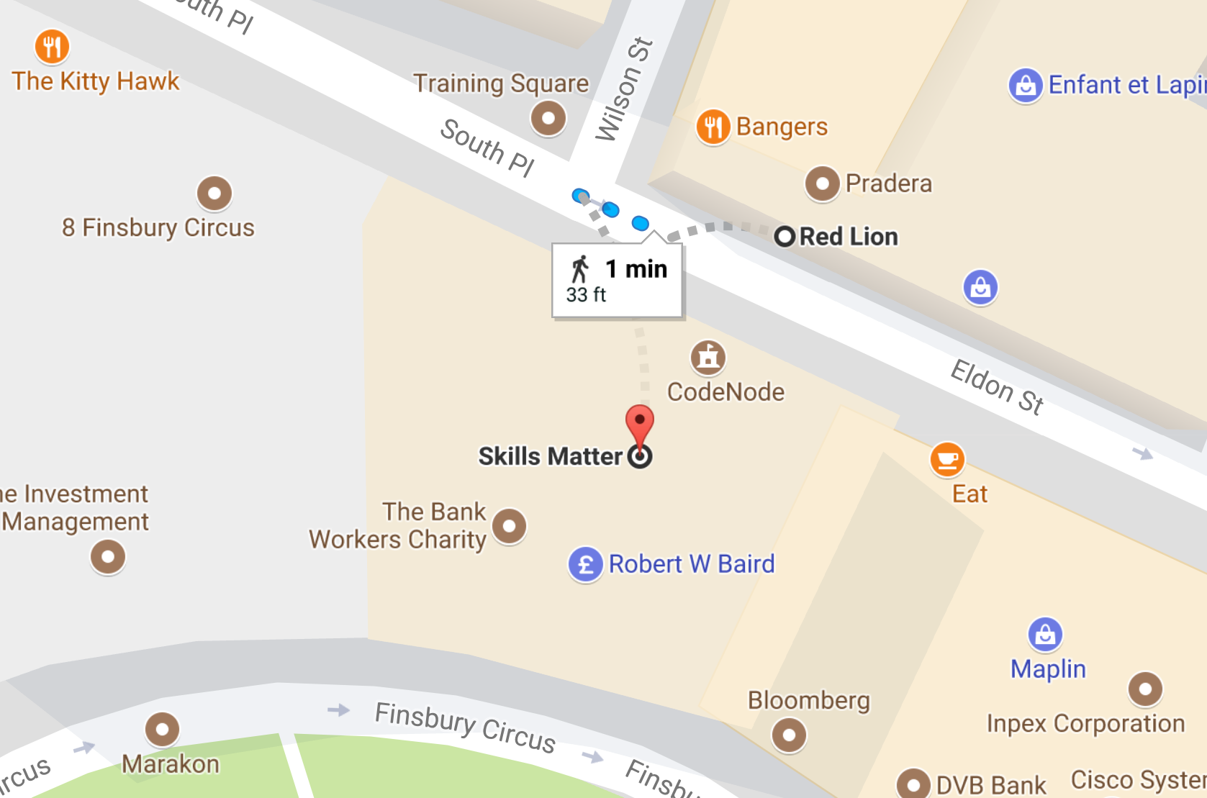
Thank You To Our Sponsors
Thank You To Our Post-Event
Drink Sponsors
Come and Join us for some drinks at the Red Lion after the event

